Slide 1
Maths
Unit 6 – Fractions and Percentages.
WALT:
6Nf.08 Understand the relative size of quantities to compare and order numbers with one or two decimal places, proper fractions with different denominators and percentages using the symbols < = and >.

Slide 2



WALT: Understand the relative size of quantities to compare and order numbers with one or two decimal places, proper fractions with different denominators and percentages using the symbols < = and >.
I can compare values using < = and >.
I can order values.
I can correct and explain mistakes when comparing and ordering values.

Slide 3
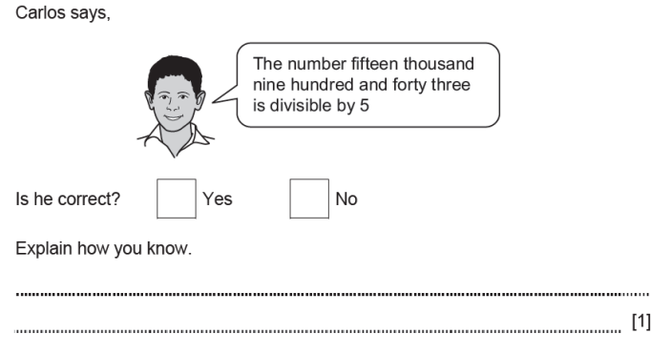
Retrieval Practice
WALT: Understand the relative size of quantities to compare and order numbers with one or two decimal places, proper fractions with different denominators and percentages using the symbols < = and >.
15,943 doesn’t end in a 5 or a 0. Every multiple of 5 ends in a 5 or a 0.

Slide 4

Starter – Which of these values is the largest?
WALT: Understand the relative size of quantities to compare and order numbers with one or two decimal places, proper fractions with different denominators and percentages using the symbols < = and >.
$$\frac{40}{99}$$
0.4
5%
How do you know?

Slide 5
What do the following symbols mean?
greater than
=
<
>
less than
equal to

Slide 6
We can compare decimals, fractions and percentages using the < = and > symbols.
WALT: Understand the relative size of quantities to compare and order numbers with one or two decimal places, proper fractions with different denominators and percentages using the symbols < = and >.
To do this we can convert them so they are in the same format.
0.8
9%
80%

Slide 7
We can compare decimals, fractions and percentages using the < = and > symbols.
WALT: Understand the relative size of quantities to compare and order numbers with one or two decimal places, proper fractions with different denominators and percentages using the symbols < = and >.
To do this we can convert them so they are in the same format.
0.8
>
9%
0.09

Slide 8

We can compare decimals, fractions and percentages using the < = and > symbols.
WALT: Understand the relative size of quantities to compare and order numbers with one or two decimal places, proper fractions with different denominators and percentages using the symbols < = and >.
60%
$$\frac{1}{5}$$
0.06

Slide 9

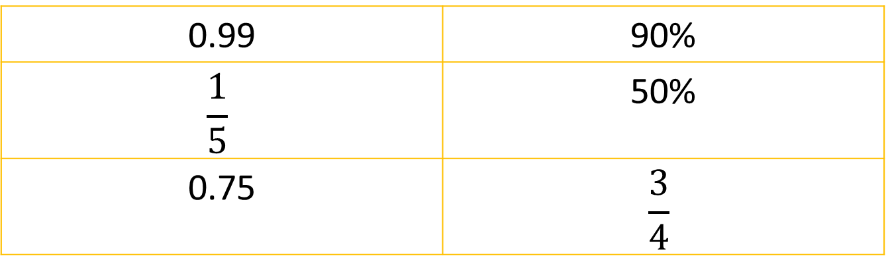

Check your understanding
WALT: Understand the relative size of quantities to compare and order numbers with one or two decimal places, proper fractions with different denominators and percentages using the symbols < = and >.
1. Use the < = and > symbols to compare these values.
0.99 | 90%
$$\frac{1}{5}$$ | 50%
0.75 | $$\frac{3}{4}$$
2. Put these values in order from smallest to greatest.
$$\frac{3}{5}$$
$$\frac{3}{5}$$
0.55
6%
6%
0.55

Slide 10
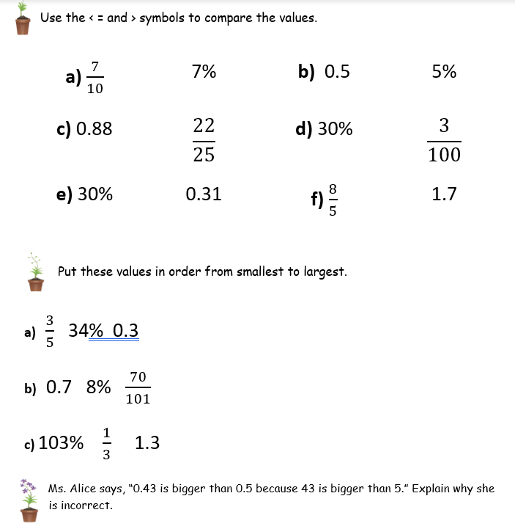
WALT: Understand the relative size of quantities to compare and order numbers with one or two decimal places, proper fractions with different denominators and percentages using the symbols < = and >.

Slide 11
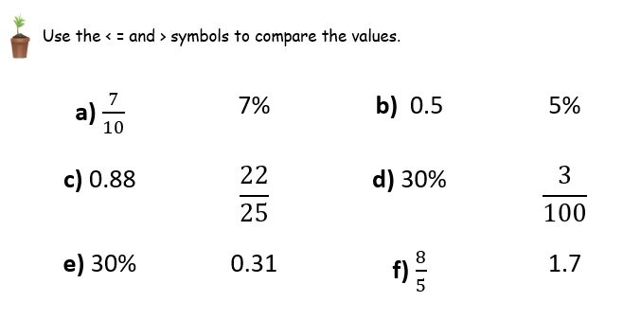
WALT: Understand the relative size of quantities to compare and order numbers with one or two decimal places, proper fractions with different denominators and percentages using the symbols < = and >.
>
>
=
>
<
<

Slide 12
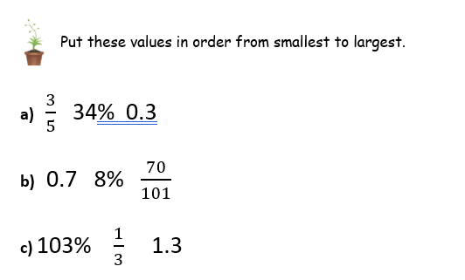
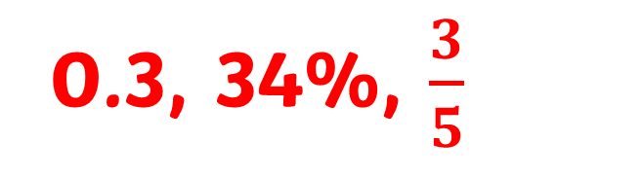
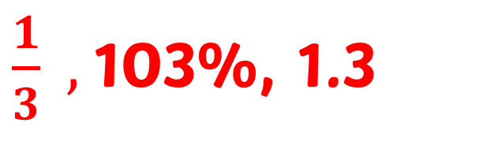
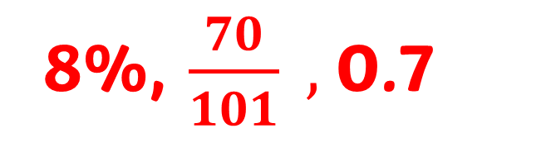
WALT: Understand the relative size of quantities to compare and order numbers with one or two decimal places, proper fractions with different denominators and percentages using the symbols < = and >.
0.3, 34%, $\frac{3}{5}$
8%, $\frac{70}{101} ,$0.7
$\frac{1}{3} ,$103%, 1.3

Slide 13
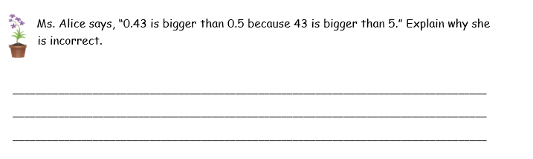
WALT: Understand the relative size of quantities to compare and order numbers with one or two decimal places, proper fractions with different denominators and percentages using the symbols < = and >.
Ms. Alice is wrong because 0.5 is not 5 hundredths it is 5 tenths which is equivalent to 50 hundredths. 0.43 is 43 hundredths. 50 hundredths is more than 43 hundredths. Therefore 0.5 is greater than 0.43.

Slide 14
WALT: Understand the relative size of quantities to compare and order numbers with one or two decimal places, proper fractions with different denominators and percentages using the symbols < = and >.
I can compare values using < = and >.
I can order values.
I can correct and explain mistakes when comparing and ordering values.

Slide 15
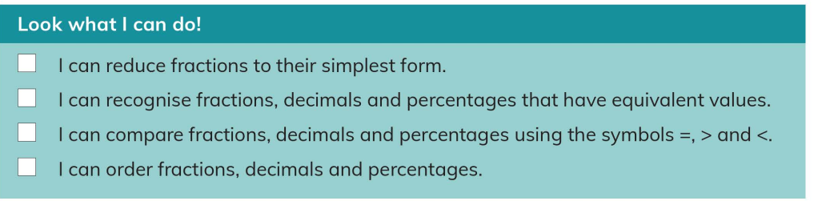
Plenary
WALT: Understand the relative size of quantities to compare and order numbers with one or two decimal places, proper fractions with different denominators and percentages using the symbols < = and >.
What can you do if you are not sure about any of these “I can….” statements?

